Slide 1

Transformer-Based Song Genre Classification
Muppetware for CIS 5300
By: Sandeep Alankar, Tanvi Gupta, Henghak Kun, Sophie Luo

Slide 2
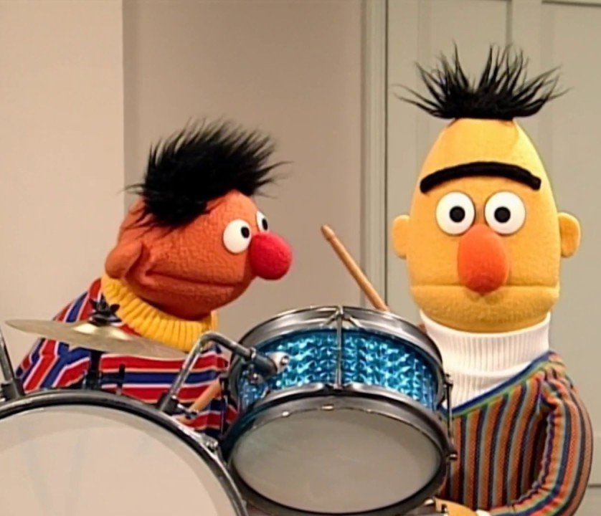
Our Aim
To develop a music genre classification system leveraging an LLM

Slide 3


Why classify songs?
We love
listening to different music genres & working with large language models
We hate
listening to a brand new song but not being able to properly search for similar songs/artists afterwards & Spotify’s lack of song-specific genre labeling
We want
to create an enhanced music recommendation system & build a model that accurately predicts music genres based on song lyrics, bridging the gap between text analysis and music classification
Notes:
-Spotify currently does not offer genre labeling for individual songs, only for artists
-Current genre classification projects use audio features in addition to lyrics, we wanted to explore the limits of LLM performance using only the lyrics

Slide 4
CIS 5300 and Us
Large Language Models
Transformers
(BERT is a transformer- based model)
Fine-tuning BERT & other LLMs
Application of NLP Concepts
Multimodality (textual lyrics + audio features like tempo)
Understanding Context and Semantics (of lyrics)
Notes:
Relate how we learned how to finetune LLM in class and we want to apply this to a task we’re interested in.

Slide 5

The Process
Fine-tune the model architecture with a dataset of song lyrics to predict the genre of songs
Model : understands the contextual nuances in lyrics
Output: genre predictions
Input: song lyrics as text
Notes:
Explain how we plan on adding additional features during the training/finetuning process in hopes of performing better

Slide 6
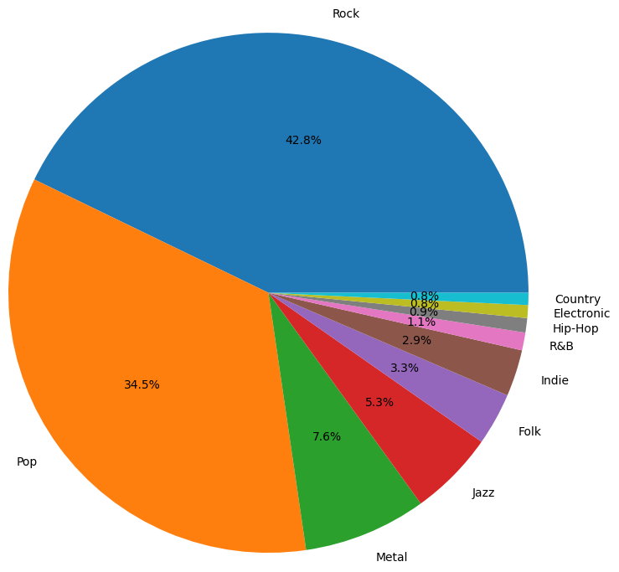
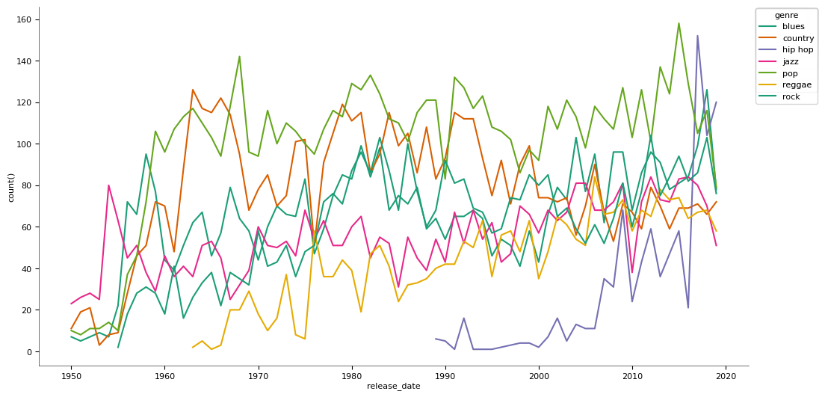
Our Dataset
290k entries (212k English entries)
Columns: Lyrics, Genre
Source: Multilingual Lyrics for Genre Classification (kaggle.com)
Notes:
10 genres (each song is assigned exactly one genre)
There are actually limited data that we could use. This is one of the few datasets that we want readily available online.
Datasets that are referenced in research papers of the past are either unavailable or updated to focus on a different task.

Slide 7
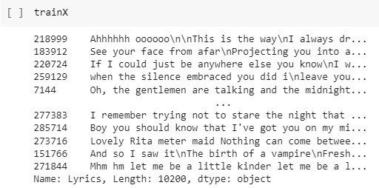
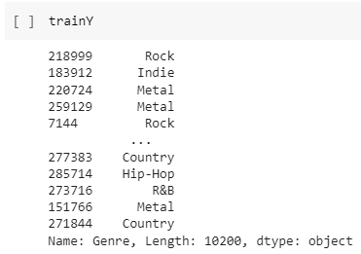
Data Preparation
Genre distribution unbalanced can overfit
Sample equal amount of entries for each genre
Train_df: sampled 10k entries (~1k per genre)

Slide 8

Evaluation
Input: predicted labels for each song, actual labels for each song, list of all possible genres.
Calculate the precision, recall, and F1-score per genre
Output:
Percent accuracy
Precision, recall, F1-score per genre
Macro precision, recall and F1-score across all genres
Weighted Average precision, recall and F1-score across all genres
Notes:
Macro averaging involves counting the total number of TP, FP, FN across all genres and computing precision, recall and F1
Weighted average involves taking each precision, recall, and F1 of each genre and do a weighted sum, where the weights are the number of examples of the genres.

Slide 9
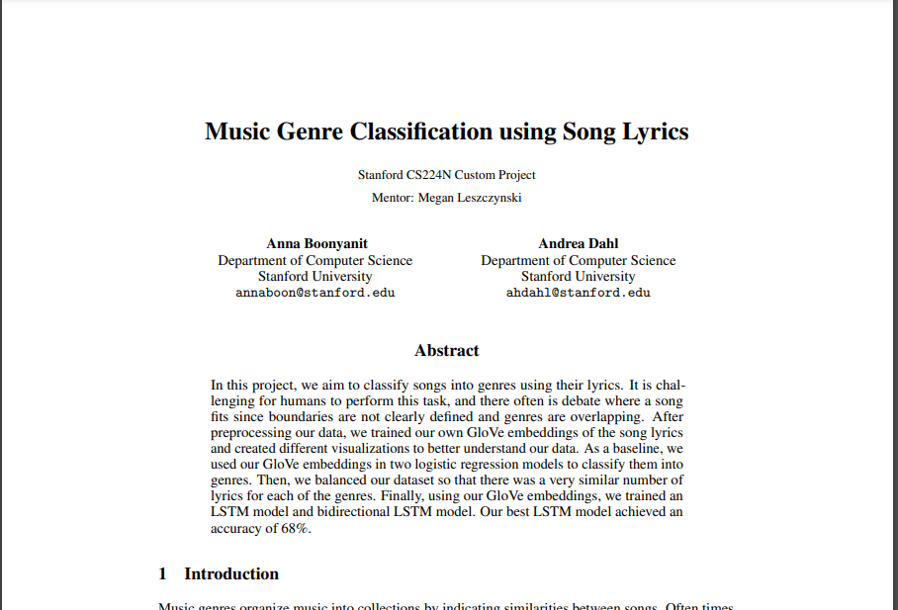
Past Approaches
Dataset
Anderson Neisse. Song lyrics from 6 musical genres, Nov 2019.
50% English songs (3 genres)
7580 songs in dataset that were labelled under more than one class.
120k oversampled training entries
Explored Approach
Baseline: Logistic Regression with Glove Embedding Average (0.64)
LSTM with Balanced Dataset and Multiple Correct Genres (0.68)
Bi-directional LSTM with Balanced Dataset (0.55)
Notes:
Emphasize how other used the same LSTM approach to try and generate song lyrics.

Slide 10
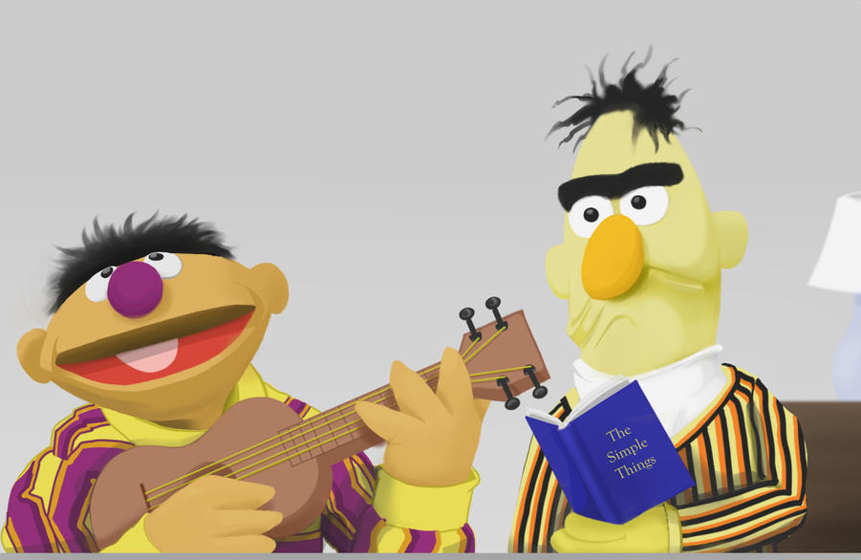
Simple Baseline
Predict majority class (Rock) for every input
Out of the 212,667 songs in our train data, approximately 43% of them were Rock, 35% of them were Pop, and the other 8 genres made up the remaining 22%
∴ we utilized a simple majority class baseline to serve as a minimal performance expectation to which we can compare our later baselines and model improvements
Notes:
-We chose a simple baseline to predict the majority class in our initial, unbalanced dataset

Slide 11

Strong Baseline - LSTM
LSTM might perform well is due to its ability to remember and form connections between a string of sequential words
Predicting song genre with deep learning - Antonijo Marijić, Marina Bagić Babac
Their implementation of LSTM yielded ~ 50% accuracy
Pytorch LSTM & GloVe Embedding

Slide 12
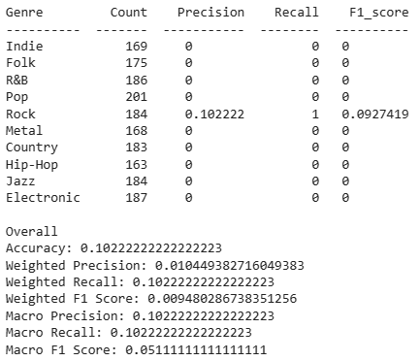
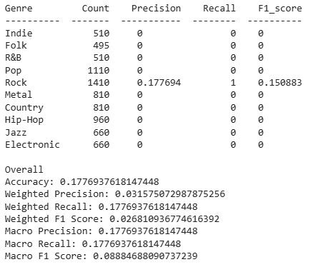
Simple Baseline - Performance
Validation
Test

Slide 13
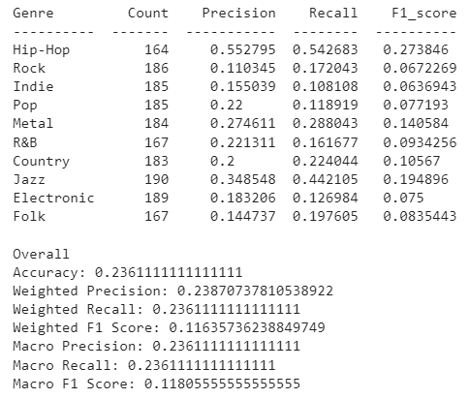
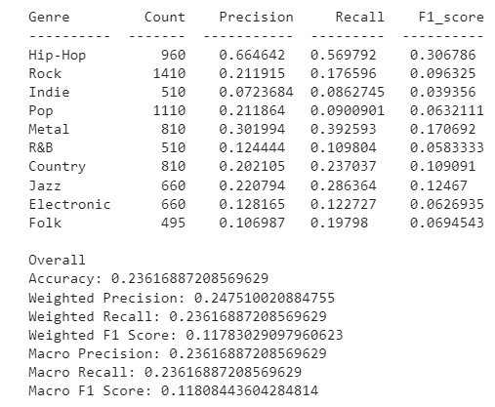
Strong Baseline - Performance
Validation
Test

Slide 14

DistilBERT
Base DistilBERT model - small size, faster runtime (using Colab GPUs) than vanilla BERT
Converted the genres to numerical labels
Employed batch tokenization (batch size of 100) to tokenize the input data
Conducted the training process over 3 epochs
Printed loss every 5000 batches and added checkpoints every 5000 steps to save progress in case of a session crash
Notes:
-We chose to use distillBERT due to its smaller sizer and faster runtime
-Used batch tokenization for faster training

Slide 15
Vanilla BERT
State-of-the-art transformer-based model
Pre-trained embeddings & attention mechanism
Make it well-suited for understanding the context & nuances in song lyrics
Longer training time but significant improvement in overall accuracy
Employed batch tokenization (batch size of 100) to tokenize the input data & conducted the training process over 3 epochs, as earlier
Notes:
-We later cut down our training set from 212k songs to just 10k to allow us to run vanilla BERT without any runtime constraints

Slide 16
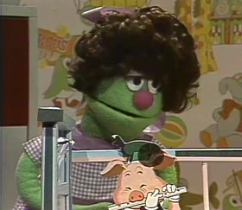
RoBERTa
Robustly optimized BERT approach
RoBERTa's training is more computationally efficient than vanilla BERT
removal of the next sentence prediction task + larger mini-batches contribute to faster convergence
Accommodates longer input sequences
Easy to use & fine-tune
Used 10k of 212k entries
Added tf-idf feature
Notes:
-To further extend beyond distillBERT and vanilla BERT, we ran RoBERTa, an optimized version of the vanilla model that uses a dynamic masking strategy during pre-training

Slide 17
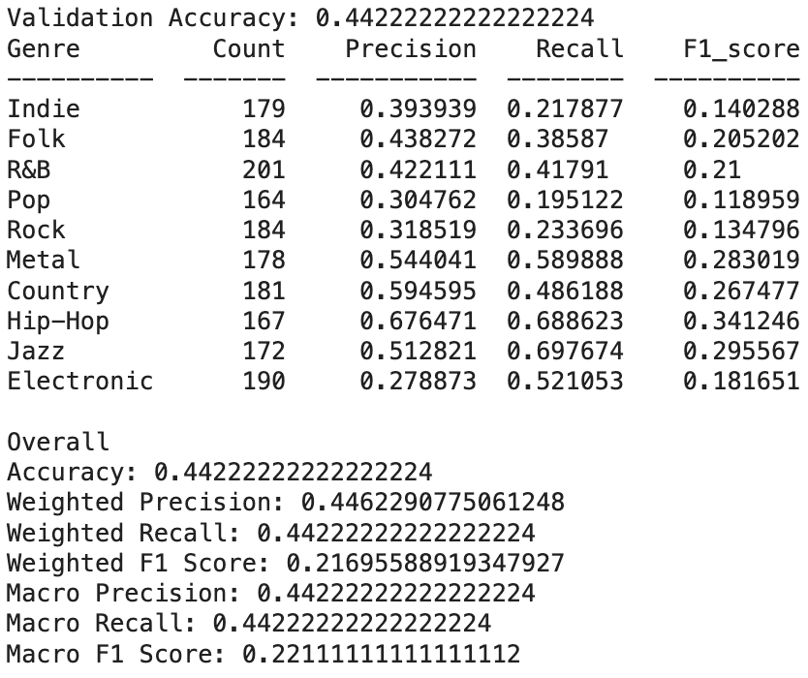
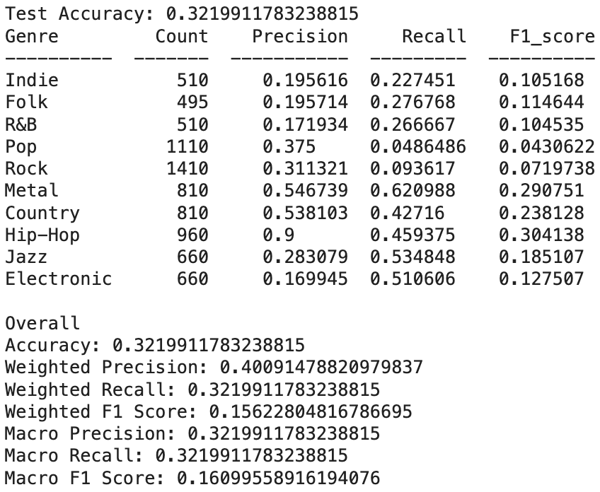
Vanilla BERT - Performance
Training
Validation
Test
Epoch 1/3
Average training loss: 1.8913040985313117
Validation Accuracy after epoch 1: 0.3739
Epoch 2/3
Average training loss: 1.5172663913754856
Validation Accuracy after epoch 2: 0.4306
Epoch 3/3
Average training loss: 1.1197702007842998
Validation Accuracy after epoch 3: 0.4422
Training complete.

Slide 18
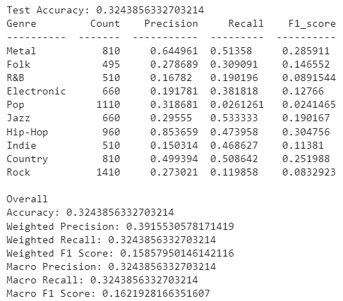
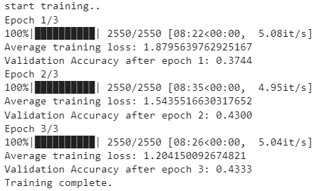
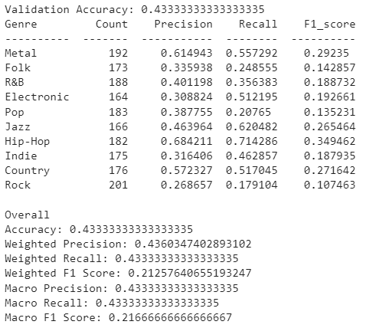
RoBERTa- Performance
Training
Validation
Test

Slide 19
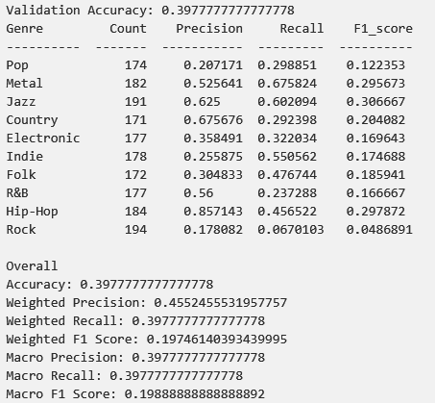
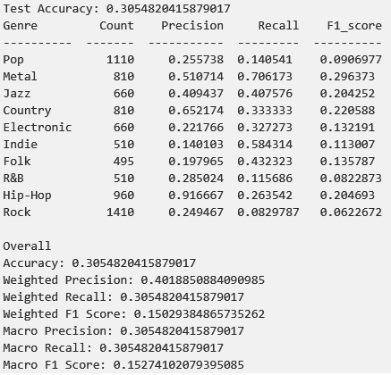
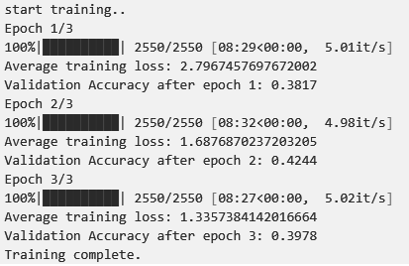
DistilBERT (tf-idf)
Training
Validation
Test

Slide 20
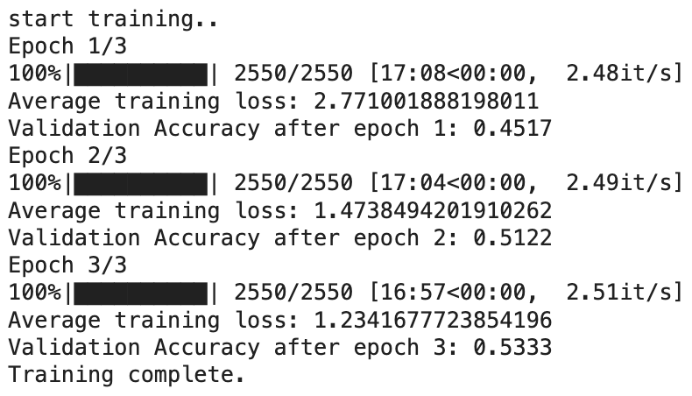
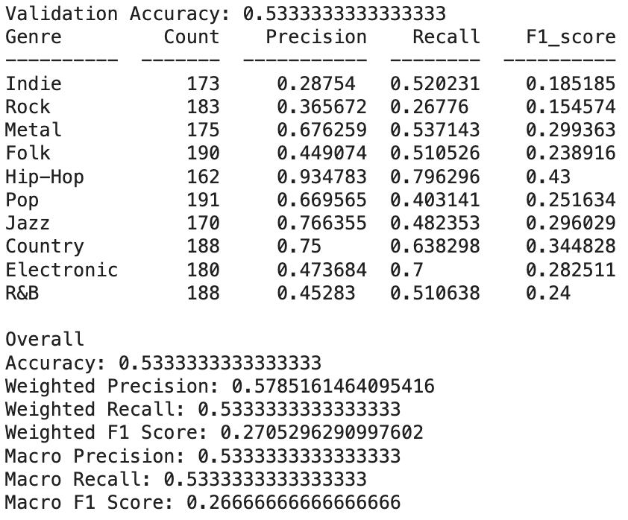
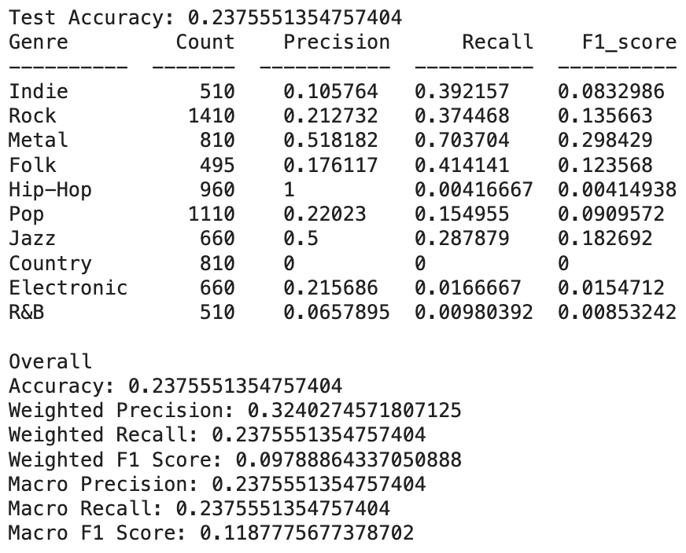
RoBERTa (tf-idf)
Training
Validation
Test
Notes:
RoBERTa with tf-idf performed worse than without it. RoBERTa itself captures rich semantic representations of words and phrases through its contextual embeddings. If the TF-IDF features overlap significantly with the information already captured by RoBERTa, it may introduce redundancy or even noise, leading to a decrease in performance.

Slide 21
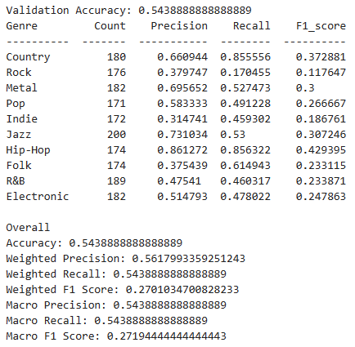
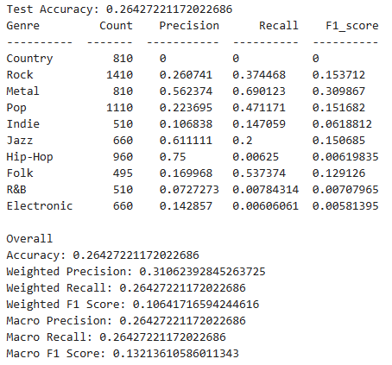
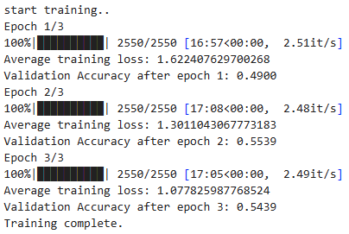
RoBERTa (sentiment analysis)
Training
Validation
Test

Slide 22
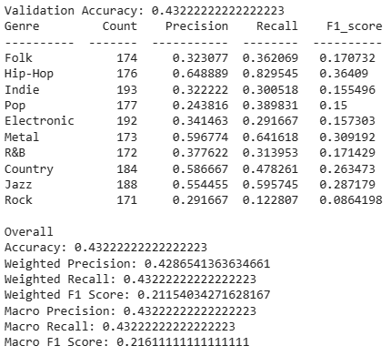
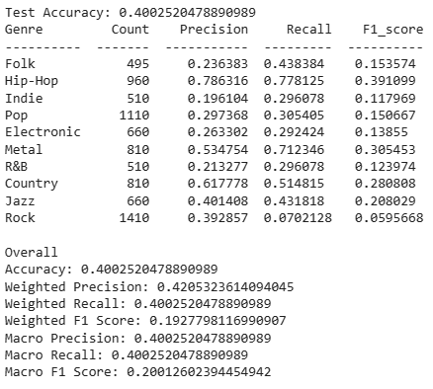
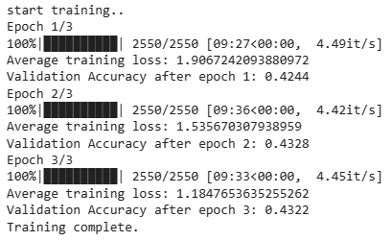
DistilBERT (sentiment analysis)
Training
Validation
Test

Slide 23
Error Analysis
Genre overlap in lyrical themes
Rock, Indie, Pop, Country and Folk. This overlap might be causing confusion for the model
Common style/mood conveyed by lyrics
Genres like Metal and Electronic
Jazz and Country
Metal and Folk
Metal and Electronic
Ambiguity in Rock leading to its misclassification
Rock is a broad genre with considerable overlap with other genres
Notes:
-We chose to use distillBERT due to its smaller sizer and faster runtime
-Used batch tokenization for faster training

Slide 24
Thank you!

